Slide 1

Technology in Action
15th Edition
Chapter 5
System Software:
The Operating System,
Utility Programs, and
File Management
Notes:
If this PowerPoint presentation contains mathematical equations, you may need to check that your computer has the following installed:
1) MathType Plugin
2) Math Player (free versions available)
3) NVDA Reader (free versions available)

Slide 2
Learning Objectives (1 of 2)
5.1 Discuss the functions of the operating system.
5.2 Explain the most common operating systems for personal use.
5.3 Explain the different kinds of operating systems for machines, networks, and business.
5.4 Explain how the operating system provides a means for users to interact with the computer.
5.5 Explain how the operating system helps manage hardware such as the processor, memory, storage, and peripheral devices.
Notes:
Slide 2 is a partial list of textbook Learning Objectives numbers and statements.

Slide 3
Learning Objectives (2 of 2)
5.6 Explain how the operating system interacts with application software.
5.7 Discuss the process the operating system uses to start up the computer and how errors in the boot process are handled.
5.8 Describe the main features of the Windows interface.
5.9 Summarize how the operating system helps keep your computer organized and manages files and folders.
5.10 Outline the tools used to enhance system productivity, back up files, and provide accessibility.
Notes:
Slide 3 is the final list of textbook Learning Objectives numbers and statements.

Slide 4
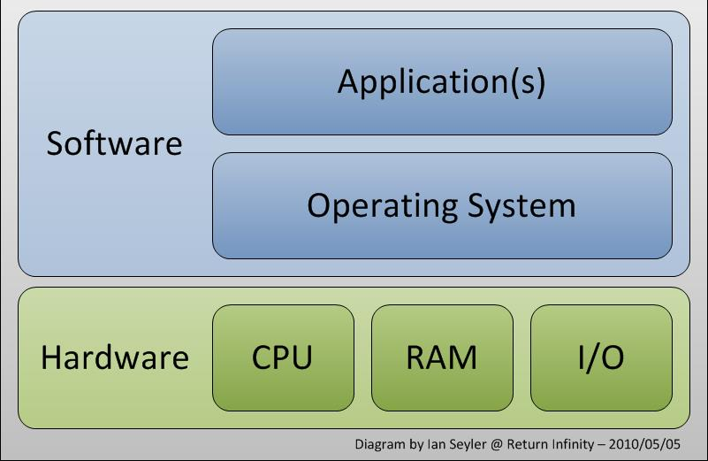
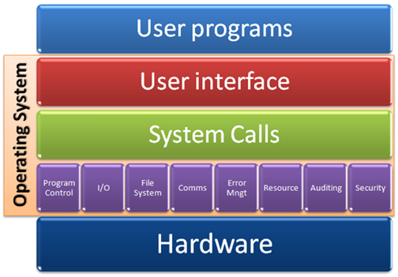
Operating System Fundamentals
Operating System Basics (1 of 3)
(Objective 5.1)
Operating system basics
  Operating system
  Utility programs
Operating system functions
  Manages computer’s hardware
  Allows application software to work with CPU
  Manage, schedule, coordinate tasks
Notes:
System software consists of two primary types of programs, the operating system and utility programs.
The operating system has three primary functions.
• It manages the computer’s hardware.
• It provides a consistent means for application software to work with the central processing unit.
• It is responsible for the management, scheduling, and coordination of tasks.

Slide 5
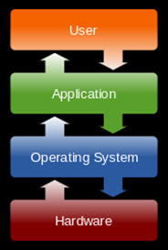
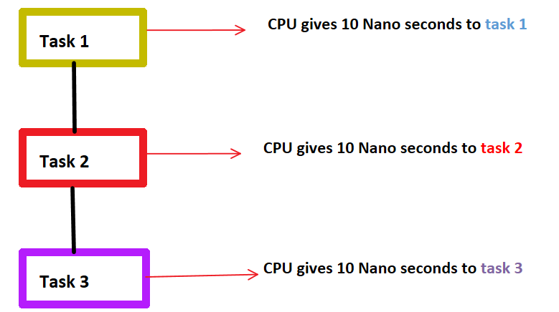
Operating System Fundamentals Operating System Basics (2 of 3) (Objective 5.1)
User Interface
  How user interacts with computer
  Desktop, icons, and menus
Multitask
  Perform more than one process at a time
Notes:
Other functions of the operating system include the user interface, which is how users interact with the computer. It includes desktop, icons, and menus.
A utility program is a small program that performs many of the general housekeeping tasks for your computer, such as system maintenance and file compression. A set of utility programs is bundled with each OS.
When operating systems were originally developed, they were designed for a single user performing one task at a time. Modern operating systems provide the ability to multitask, which means that the computer can perform more than one process at a time.

Slide 6
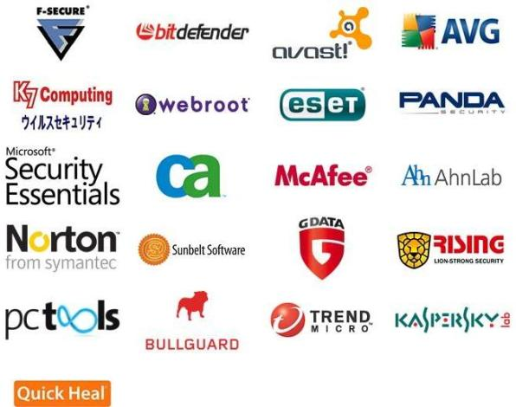
Operating System Fundamentals Operating System Basics (2 of 3) (Objective 5.1)
Utility Program
  Performs general housekeeping tasks
Notes:
Other functions of the operating system include the user interface, which is how users interact with the computer. It includes desktop, icons, and menus.
A utility program is a small program that performs many of the general housekeeping tasks for your computer, such as system maintenance and file compression. A set of utility programs is bundled with each OS.
When operating systems were originally developed, they were designed for a single user performing one task at a time. Modern operating systems provide the ability to multitask, which means that the computer can perform more than one process at a time.

Slide 7
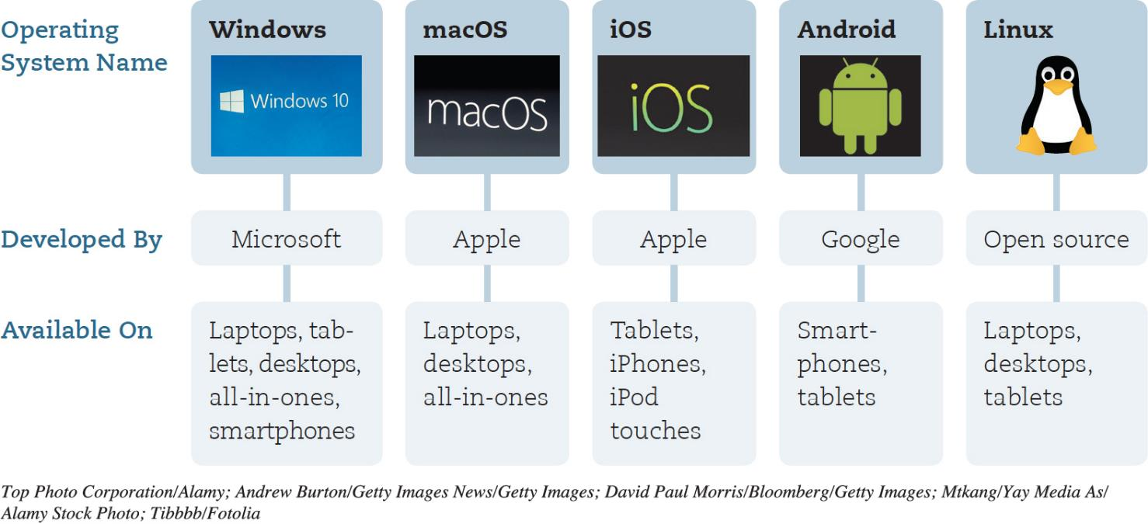
Operating System Fundamentals Operating System Basics (3 of 3) (Objective 5.1)
Notes:
Figure 5.1 lists a number of common operating systems.

Slide 8
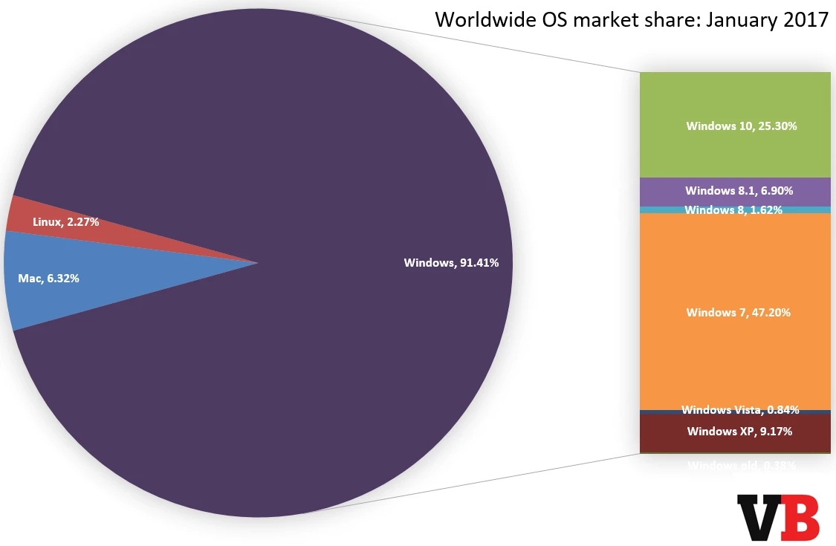
Understanding System Software
Operating Systems for Personal Use (1 of 2) (Objective 5.2)
Top three for personal computers
  Windows
  macOS
  Linux
Notes:
The top three operating systems for personal computers are:
Microsoft Windows
Apple’s macOS
Linux
Personal devices require special operating systems as well. These include:
Android
iOS
Microsoft Windows
Google Chrome OS (see Figure 5.2), is a web-based OS. With the Chrome OS, virtually no files are installed on your computing device. Rather, the main functionality of the OS is provided through a web browser.

Slide 9
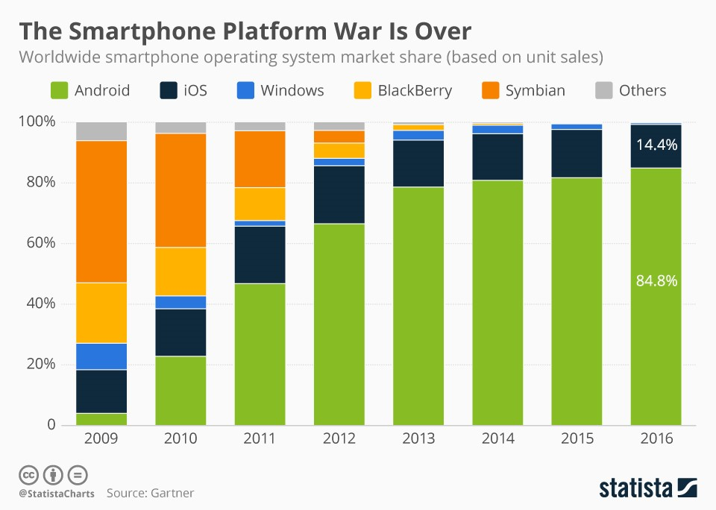
Understanding System Software
Operating Systems for Personal Use (1 of 2)
(Objective 5.2)
Mobile OS
  Android
  iOS
  Windows
Notes:
The top three operating systems for personal computers are:
Microsoft Windows
Apple’s macOS
Linux
Personal devices require special operating systems as well. These include:
Android
iOS
Microsoft Windows
Google Chrome OS (see Figure 5.2), is a web-based OS. With the Chrome OS, virtually no files are installed on your computing device. Rather, the main functionality of the OS is provided through a web browser.

Slide 10
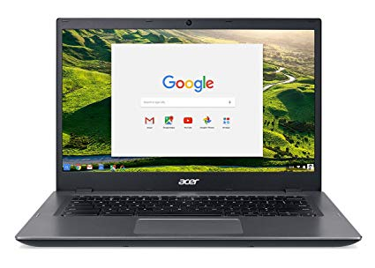
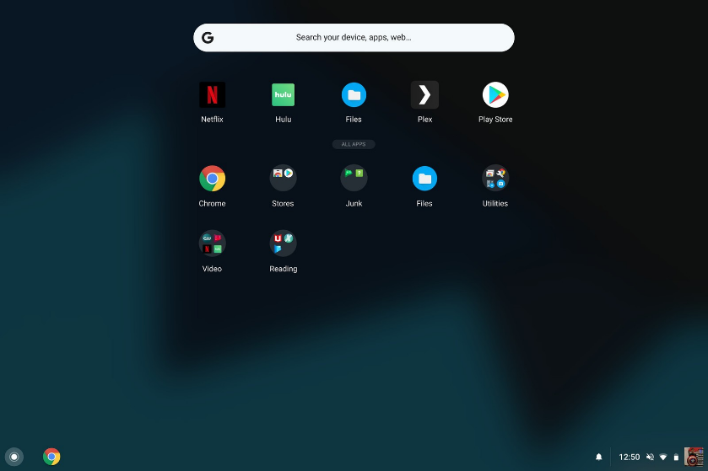
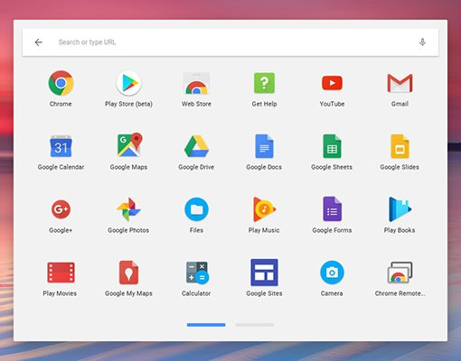
Understanding System Software
Operating Systems for Personal Use (1 of 2)
(Objective 5.2)
Web-based
  Google Chrome OS
Notes:
The top three operating systems for personal computers are:
Microsoft Windows
Apple’s macOS
Linux
Personal devices require special operating systems as well. These include:
Android
iOS
Microsoft Windows
Google Chrome OS (see Figure 5.2), is a web-based OS. With the Chrome OS, virtually no files are installed on your computing device. Rather, the main functionality of the OS is provided through a web browser.

Slide 11
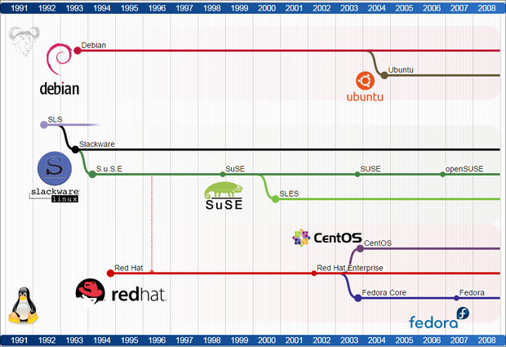
Understanding System Software
Operating Systems for Personal Use (2 of 2)
(Objective 5.2)
Linux
  Open source
  Personal computers
  Web servers
  Distributions (Distros)
Notes:
Linux is an open source OS designed for use on personal computers and web servers.
Linux is available for download in various packages known as distributions or distros.
The combination of an OS and a specific processor is referred to as a computer’s platform.
The decision to update to the newest features of your OS depends on which OS you’re using.

Slide 12
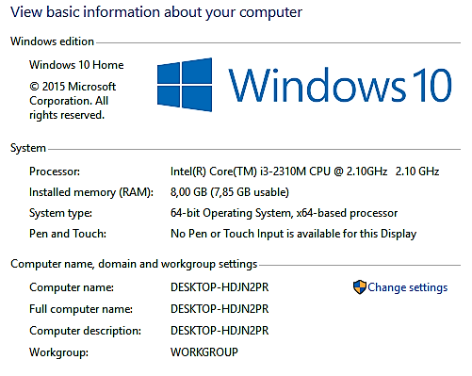
Understanding System Software
Operating Systems for Personal Use (2 of 2)
(Objective 5.2)
Platform
Upgrade OS decision?
Notes:
Linux is an open source OS designed for use on personal computers and web servers.
Linux is available for download in various packages known as distributions or distros.
The combination of an OS and a specific processor is referred to as a computer’s platform.
The decision to update to the newest features of your OS depends on which OS you’re using.

Slide 13
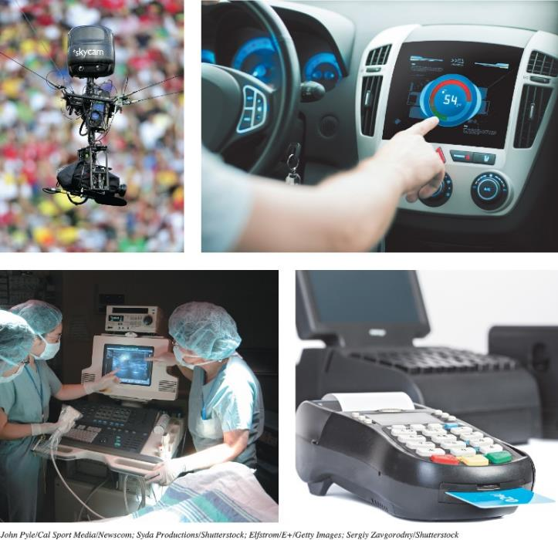
Understanding System Software
Operating Systems for Machinery, Networks, and Business
(Objective 5.3)
Real-Time OS (RTOS)
  Machine that performs repetitive series of specific tasks in precise time
Multiuser Operating System
  Known as network OS
  Allows multiple users access to computer at the same time
  Unix
Notes:
Specialized operating systems are needed for machinery, networks, and business.
Machinery that performs a repetitive series of specific tasks in an exact amount of time requires a real-time operating system (RTOS).
Multiuser operating systems allow multiple users access to the computer at the same time.
UNIX is a multiuser, multitasking OS that is used as a network OS.

Slide 14
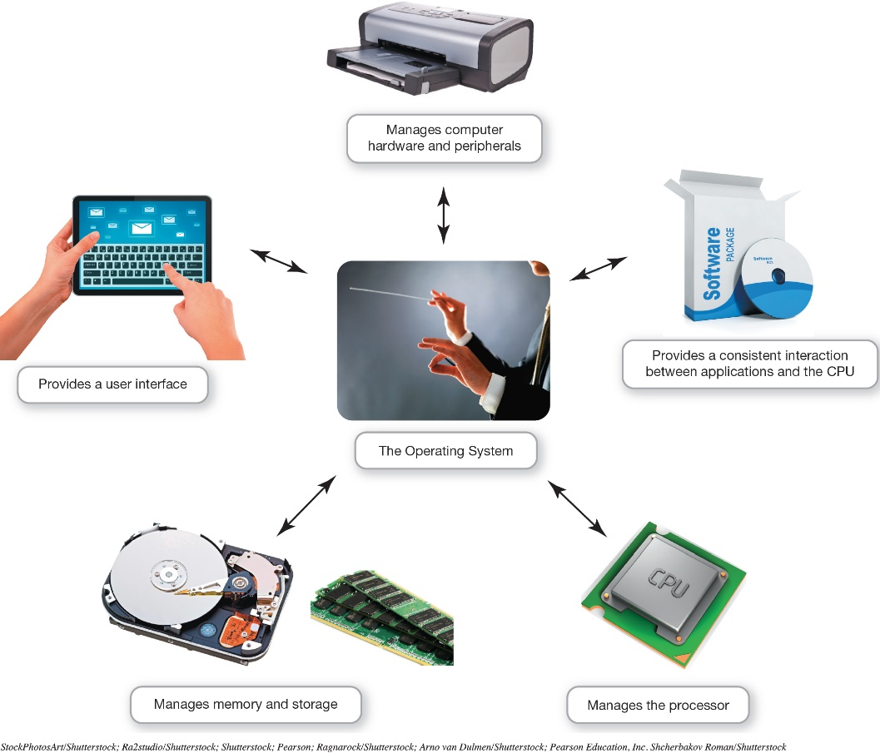
What the Operating System Does
The User Interface (1 of 2)
(Objective 5.4)
OS—Coordinates and directs the flow of data and information
Notes:
The operating system is like an orchestra's conductor. It coordinates and directs the flow of data and information through the computer system.

Slide 15
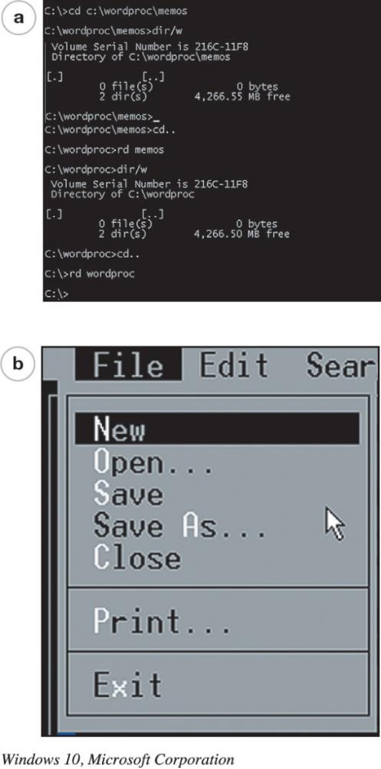
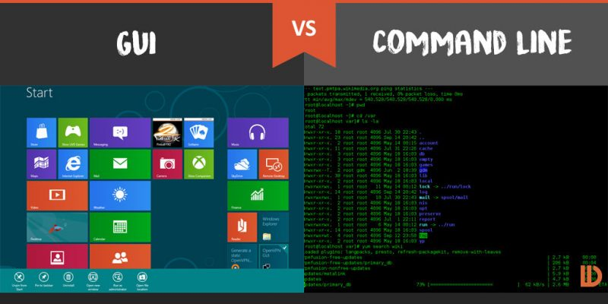
What the Operating System Does
The User Interface (2 of 2)
(Objective 5.4)
Enables user to interact with the computer
Types of interfaces
  Command-driven interface
  Menu-driven interface
  Graphical user interface (GUI)
Notes:
The OS provides a user interface that lets you interact with the computer.
In a command-driven interface, you enter commands to communicate with the computer system.
A menu-driven interface is one in which you choose commands from menus displayed on the screen. This eliminated the need for users to know every command.
Current operating systems use a graphical user interface (GUI). GUIs display graphics and use the point-and-click technology of the mouse and cursor.

Slide 16
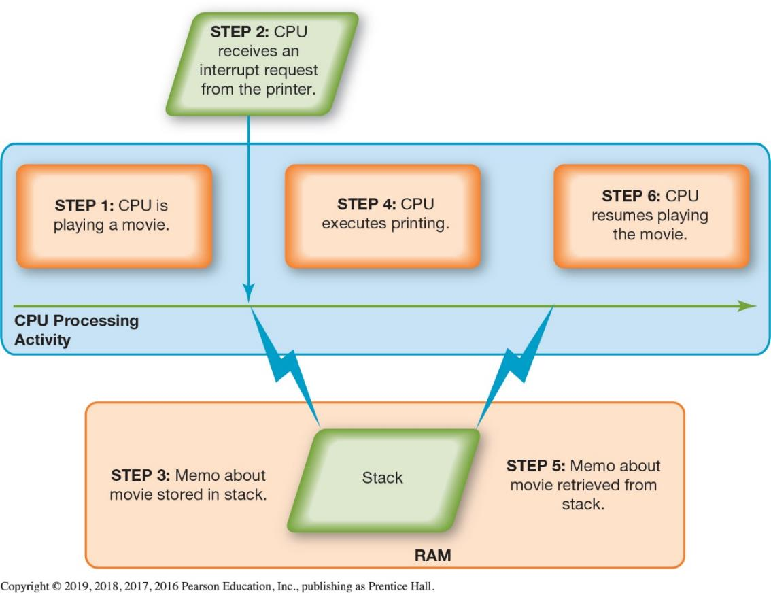
What the Operating System Does
Hardware Coordination (1 of 3)
(Objective 5.5)
Event
Interrupt handler
Preemptive multitasking
Spooler
Notes:
Every keystroke, every mouse click (or touch on the screen), and each signal to the printer and from the Blu-ray drive creates an action, or event, in the respective device to which the OS responds.
Every device has its own type of interrupt, which is associated with an interrupt handler, a special numerical code that prioritizes the requests.
These requests are placed in the interrupt table in the computer’s primary memory (RAM). The OS processes the task assigned a higher priority before processing a task assigned a lower priority. This is called preemptive multitasking.
The spooler is a program that helps coordinate all print jobs currently being sent to the printer.

Slide 17
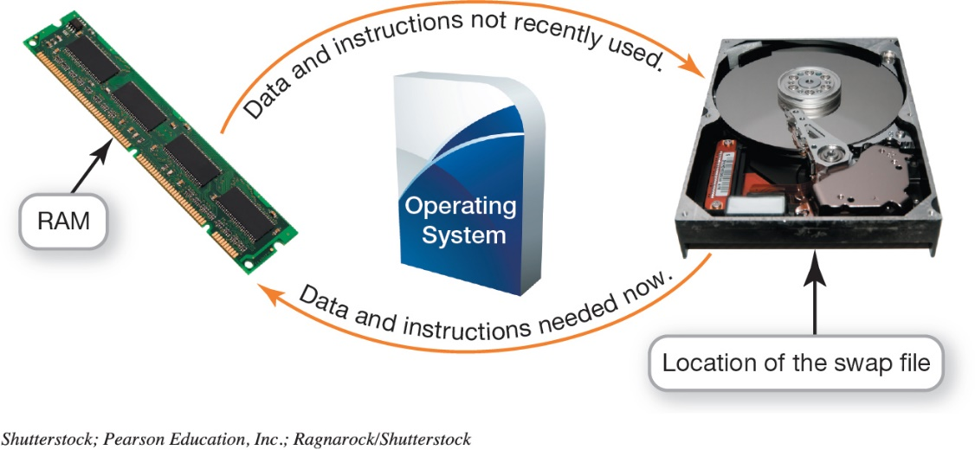
What the Operating System Does Hardware Coordination (2a of 3)
(Objective 5.5)
Memory and Storage Management
  RAM—limited capacity
  Borrowing drive space → virtual memory
  ↑ RAM ↓ virtual memory use
Notes:
RAM has limited capacity.
When there isn’t enough room in RAM, it borrows room from the hard drive.
Borrowing hard drive space is called virtual memory.
When more RAM is needed, the OS swaps out from RAM the data or instructions that haven't been used recently and moves them to a temporary storage area on the hard drive.
Increasing the amount of RAM helps the computer to avoid having to send data and instructions to virtual memory.
The process of swapping is known as paging.
Excessive paging is called thrashing.

Slide 18
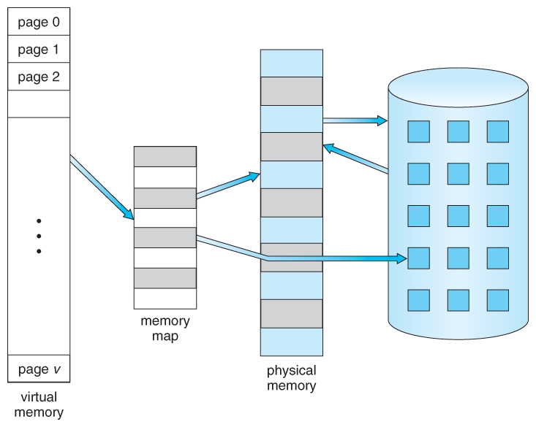

What the Operating System Does
Hardware Coordination (2b of 3)
(Objective 5.5)
Needed, put back into memory
Memory and Storage Management
  Swap file
  Paging
File on disk
(swap/page file)
Thrashing
Not being used, move out of memory
Notes:
The process of swapping is known as paging.
Excessive paging is called thrashing.

Slide 19
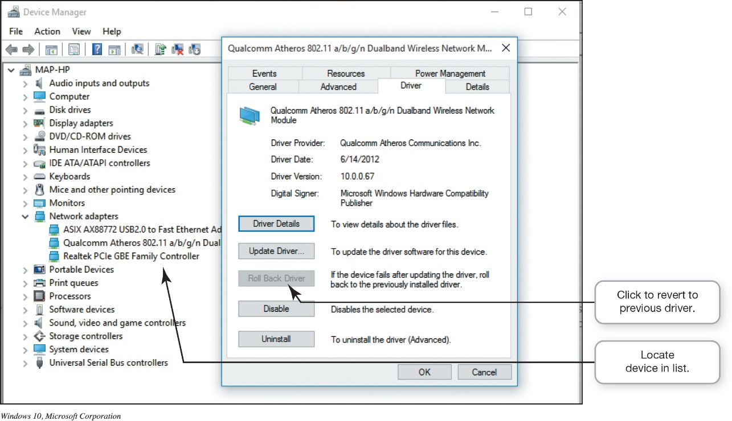
What the Operating System Does
Hardware Coordination (3 of 3)
(Objective 5.5)
Hardware and Peripheral Device Management
  Device driver
  Plug and Play (PnP)
Notes:
Each device attached to your computer comes with a special program called a device driver that facilitates communication between the device and the OS.
Plug and Play (PnP) is a software and hardware standard designed to facilitate the installation of new hardware in PCs by including in the OS the drivers these devices need in order to run.

Slide 20
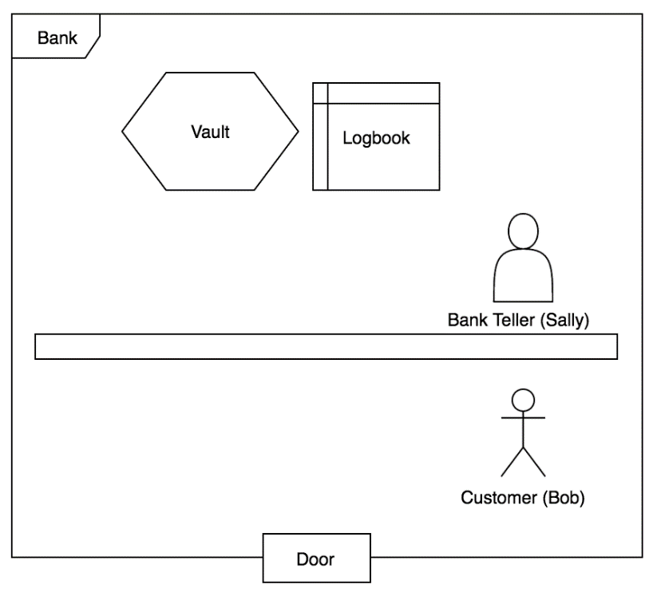
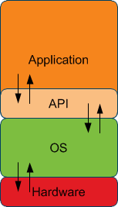
What the Operating System Does
Software Application Coordination
(Objective 5.6)
Application Programming Interface (API)
  Blocks of code the CPU recognizes
  Used for similar procedures
  Example: Microsoft Direct X
“Bank API”
Notes:
Every computer program, no matter what its type or manufacturer, needs to interact with the CPU using computer code.
Rather than having the same blocks of code for similar procedures in each program, the OS includes the blocks of code, called Application Programming Interface.
Microsoft DirectX, for example, is a group of multimedia APIs built into the Windows OS that improves graphics and sounds.

Slide 21
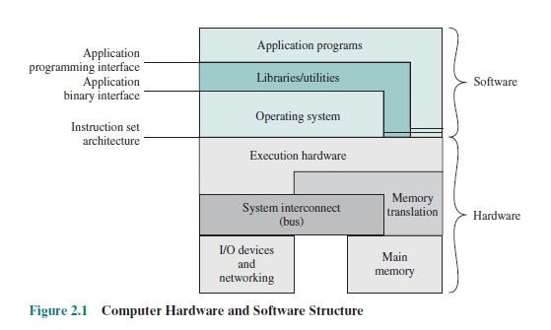
What the Operating System Does
Software Application Coordination
(Objective 5.6)
Application Programming Interface (API)
  Blocks of code the CPU recognizes
  Used for similar procedures
  Example: Microsoft Direct X
Notes:
Every computer program, no matter what its type or manufacturer, needs to interact with the CPU using computer code.
Rather than having the same blocks of code for similar procedures in each program, the OS includes the blocks of code, called Application Programming Interface.
Microsoft DirectX, for example, is a group of multimedia APIs built into the Windows OS that improves graphics and sounds.

Slide 22
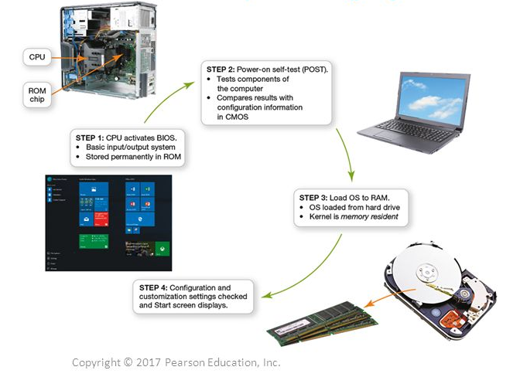
Starting Your Computer
The Boot Process (1a of 4)
(Objective 5.7)
Step 1: Activate BIOS
Step 2: Perform Power-On Self-Test (POST)
Step 3: Load OS
Step 4: Check Further Config. & Custom.
Notes:
The boot process consists of four basic steps:
Step 1: Activating BIOS
This manages the exchange of data between the OS and the input and output devices.
The BIOS is also responsible for loading the OS into RAM.
Step 2: Performing the Power-On Self-Test
This ensures that essential peripheral devices are attached and operational.

Slide 23
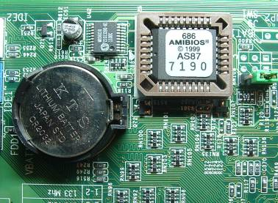
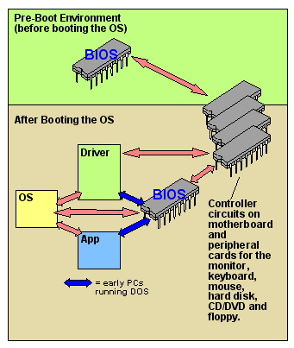
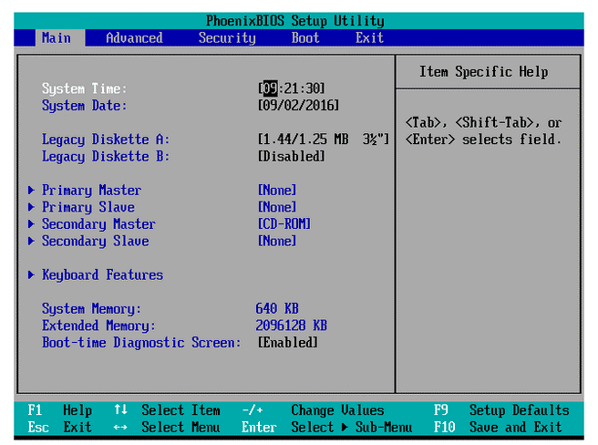
Starting Your Computer
The Boot Process (1b of 4)
(Objective 5.7)
Step 1: Activate BIOS
Step 2: Perform Power-On Self-Test (POST)
Step 3: Load OS
Step 4: Check Further Config. & Custom.
Step 1: Activating BIOS
  Manages exchange of data between OS and input/output devices
  BIOS is also responsible for loading OS into RAM
Notes:
The boot process consists of four basic steps:
Step 1: Activating BIOS
This manages the exchange of data between the OS and the input and output devices.
The BIOS is also responsible for loading the OS into RAM.
Step 2: Performing the Power-On Self-Test
This ensures that essential peripheral devices are attached and operational.

Slide 24
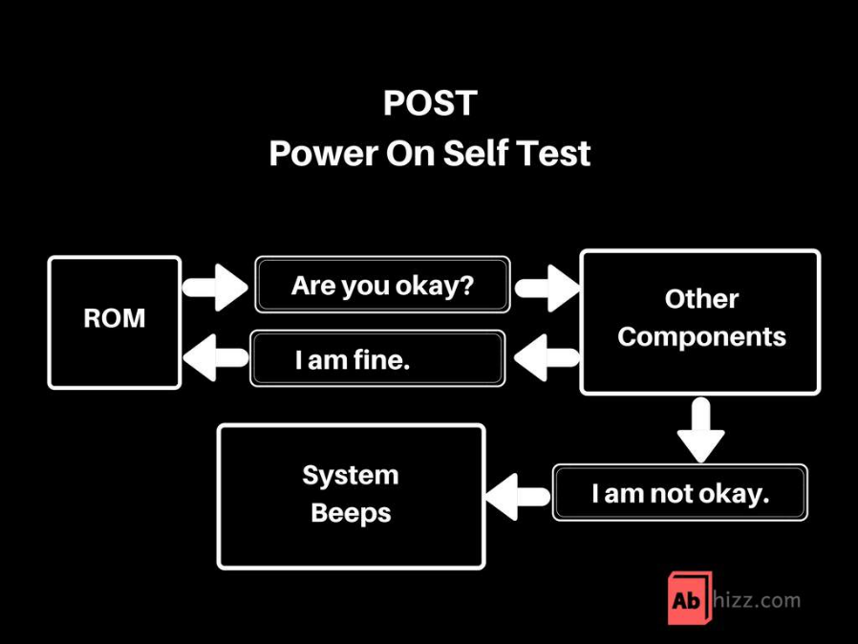
Starting Your Computer
The Boot Process (2 of 4)
(Objective 5.7)
Step 1: Activate BIOS
Step 2: Perform Power-On Self-Test (POST)
Step 3: Load OS
Step 4: Check Further Config. & Custom.
Step 2: Performing the Power-On Self-Test
  Ensures that essential peripheral devices are attached and operational
Notes:
The boot process consists of four basic steps:
Step 1: Activating BIOS
This manages the exchange of data between the OS and the input and output devices.
The BIOS is also responsible for loading the OS into RAM.
Step 2: Performing the Power-On Self-Test
This ensures that essential peripheral devices are attached and operational.

Slide 25
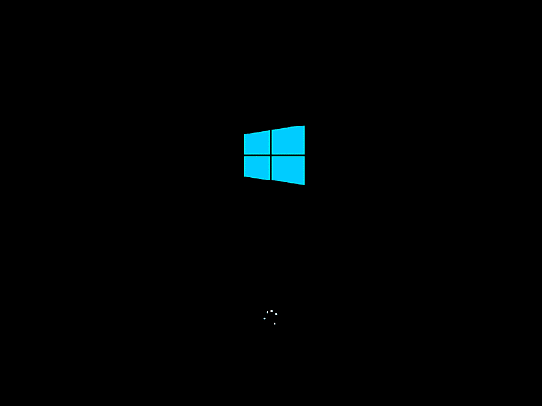
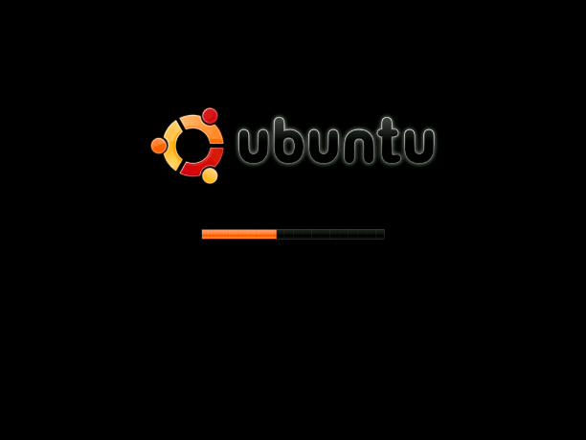
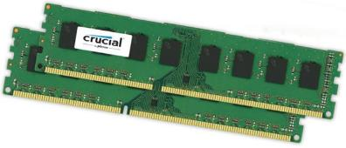
Starting Your Computer
The Boot Process (3 of 4)
(Objective 5.7)
Step 1: Activate BIOS
Step 2: Perform Power-On Self-Test (POST)
Step 3: Load OS
Step 4: Check Further Config. & Custom.
Step 3: Loading the OS (takes longest amount of time)
  System files loaded into RAM
  Kernel, essential component of the OS, is then loaded
System files
& Kernel
Notes:
The boot process consists of four basic steps: (cont)
Step 3: Loading the OS
System files are loaded into RAM.
The kernel, the essential component of the OS, is then loaded.
Step 4: Checking Further Configurations and Customizations
The registry contains configurations used by the OS and applications.

Slide 26
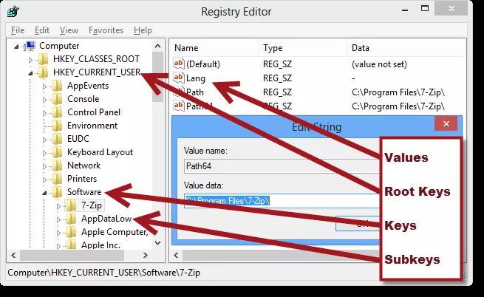
Starting Your Computer
The Boot Process (4 of 4)
(Objective 5.7)
Step 1: Activate BIOS
Step 2: Perform Power-On Self-Test (POST)
Step 3: Load OS
Step 4: Check Further Config. & Custom.
Step 4: Checking Further Configurations and Customizations
  Registry contains configurations used by the OS and applications
Notes:
The boot process consists of four basic steps: (cont)
Step 3: Loading the OS
System files are loaded into RAM.
The kernel, the essential component of the OS, is then loaded.
Step 4: Checking Further Configurations and Customizations
The registry contains configurations used by the OS and applications.

Slide 27
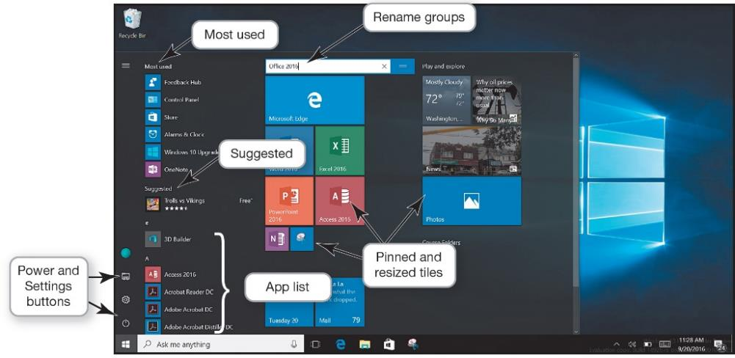
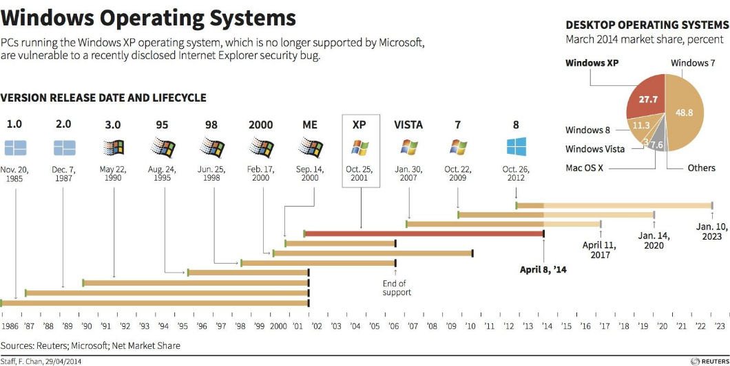
The Windows Interface
Using Windows 10 (1a of 3)
(Objective 5.8)
Desktop
  Primary working area
Taskbar
  Displays open and
  favorite applications for easy access
Start Menu
  Provides access to all applications and apps installed on your device
Notes:
The Desktop is the primary working area on the computer.
The Taskbar displays open and favorite applications for easy access.
The Start Menu provides access to all applications and apps installed on your device.

Slide 28
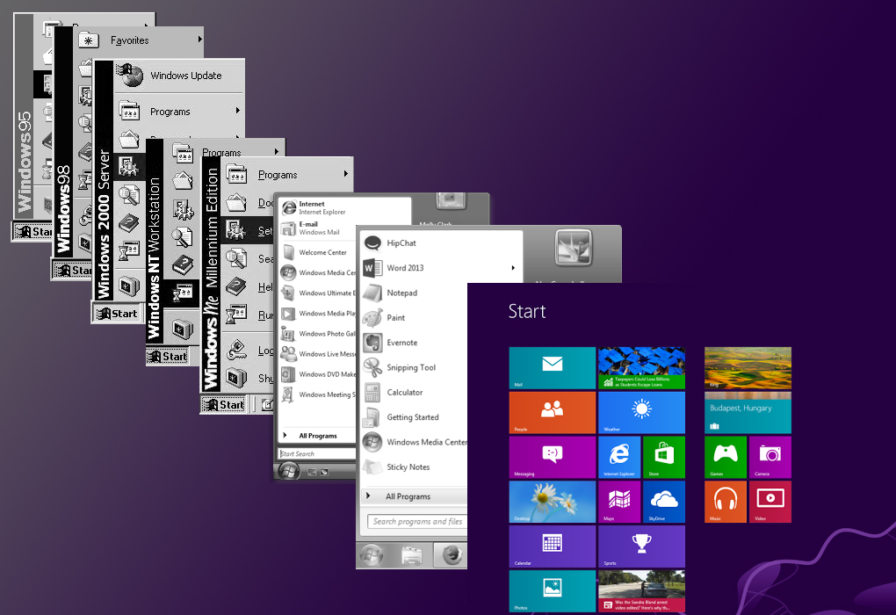
The Windows Interface
Using Windows 10 (1b of 3)
(Objective 5.8)
Start Menu
  Provides access to all applications and apps installed on your device
Notes:
The Desktop is the primary working area on the computer.
The Taskbar displays open and favorite applications for easy access.
The Start Menu provides access to all applications and apps installed on your device.

Slide 29
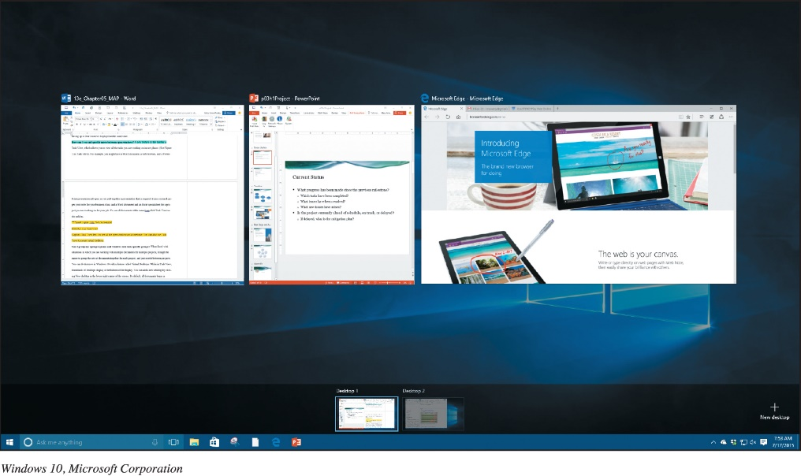
The Windows Interface
Using Windows 10 (2 of 3)
(Objective 5.8)
Pinning
  Choosing which applications are tiles on the Start menu
Virtual desktops
  Allow you to organize groups of windows
  into different displays
Notes:
Pinning is the process of choosing which applications are tiles on the Start menu.
Virtual desktops allow you to organize groups of windows into different displays.

Slide 30
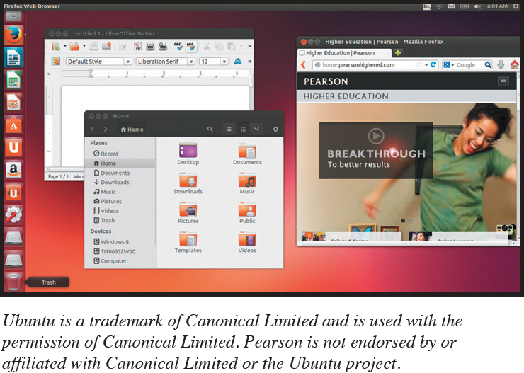
The Windows Interface
Using Windows 10 (3 of 3)
(Objective 5.8)
macOS and Windows
  Not compatible with each other
  Similar in functionality
Linux
  Most interfaces are based on familiar Windows and macOS paradigms
Notes:
Although the macOS and the Windows operating systems aren’t compatible, they’re extremely similar in terms of functionality.
Different versions of Linux feature different user interfaces, but most of them, like Ubuntu, are based on familiar Windows and macOS paradigms such as using icons to launch programs and having apps run in a window environment.

Slide 31
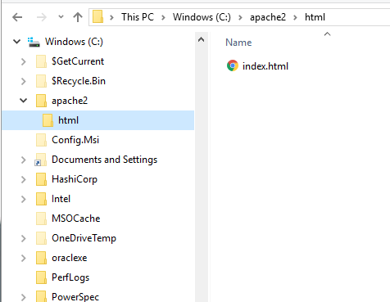
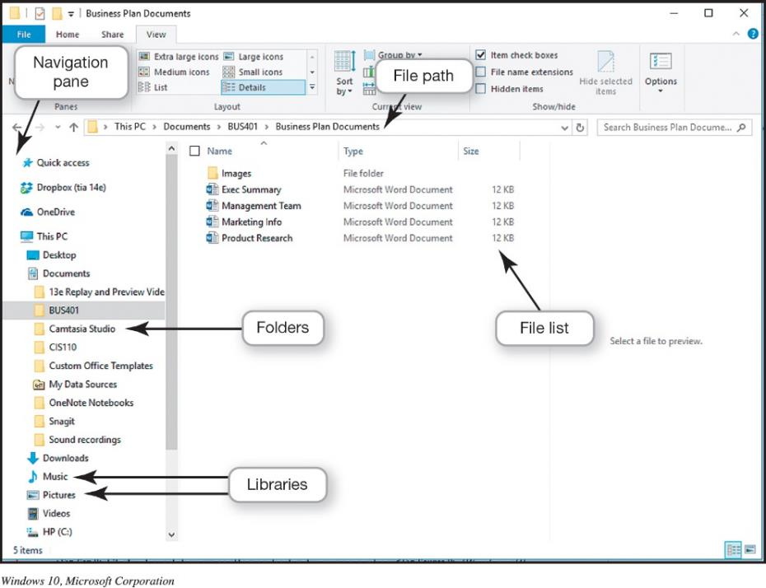
File Management
Organizing Your Files (1 of 6)
(Objective 5.9)
Directory
  Hierarchical structure of computer’s contents
    Drives
    Libraries
    Folders
    Subfolders
    Files
Root directory
- Top of the filing structure
Notes:
An additional function of the OS is to enable file management, which provides an organizational structure to the computer’s contents.
Windows organizes your computer in a hierarchical directory structure composed of drives, libraries, folders, subfolders, and files.
The C: drive is like a large filing cabinet in which all files are stored. The C: drive is the top of the filing structure of your computer, referred to as the root directory.

Slide 32

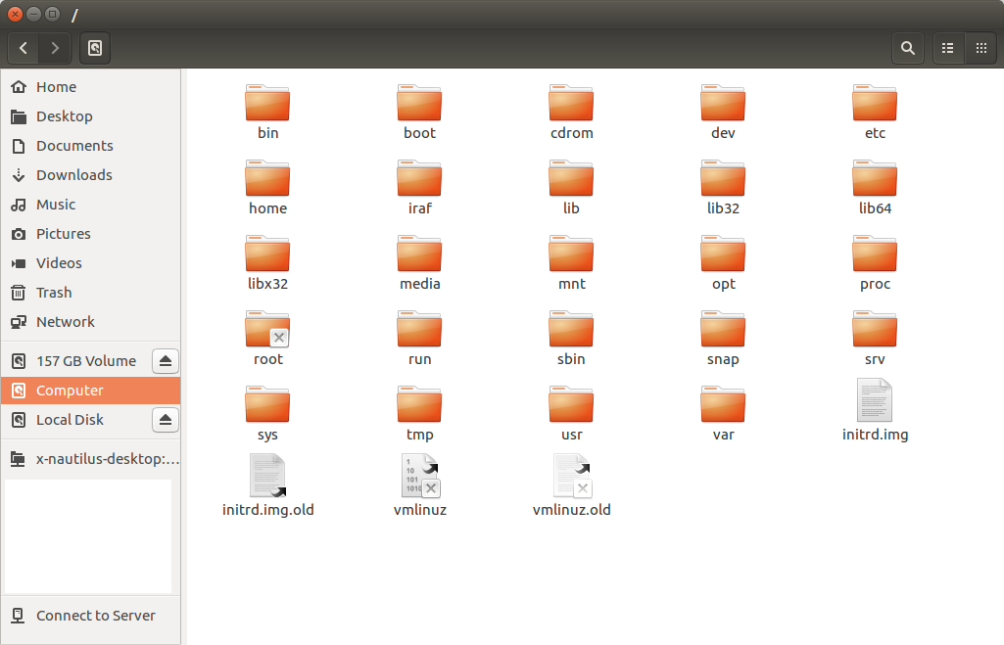
File Management
Organizing Your Files (2 of 6)
(Objective 5.9)
File
  Collection of program instructions or data
  Treated as a single unit
  Stored on permanent storage device
File Explorer
  Main tool for finding, viewing, and managing the contents of the computer
  File path / path separator
Notes:
In an OS, a file is a collection of program instructions or data that is stored and treated as a single unit.
In Windows, File Explorer is the main tool for finding, viewing, and managing the contents of your computer.

Slide 33
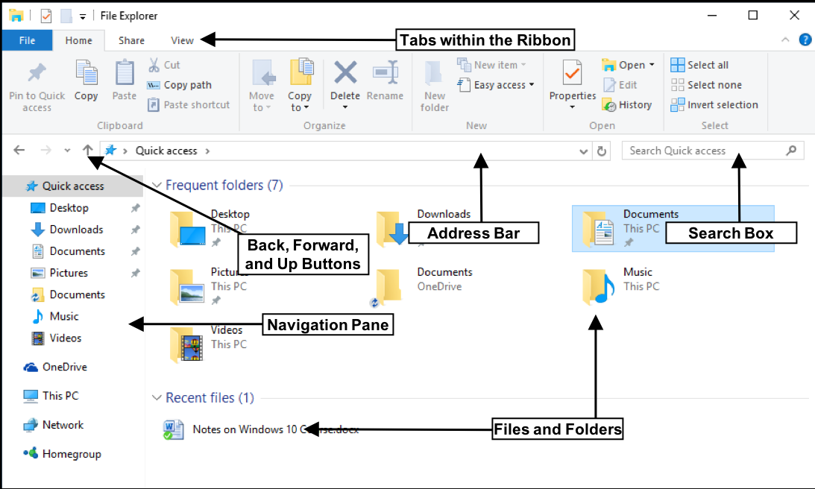
File Management Organizing Your Files (2 of 6) (Objective 5.9)
Windows File Explorer
  Main tool for finding, viewing, and managing the contents of the computer
  File path / path separator
Notes:
In an OS, a file is a collection of program instructions or data that is stored and treated as a single unit.
In Windows, File Explorer is the main tool for finding, viewing, and managing the contents of your computer.

Slide 34
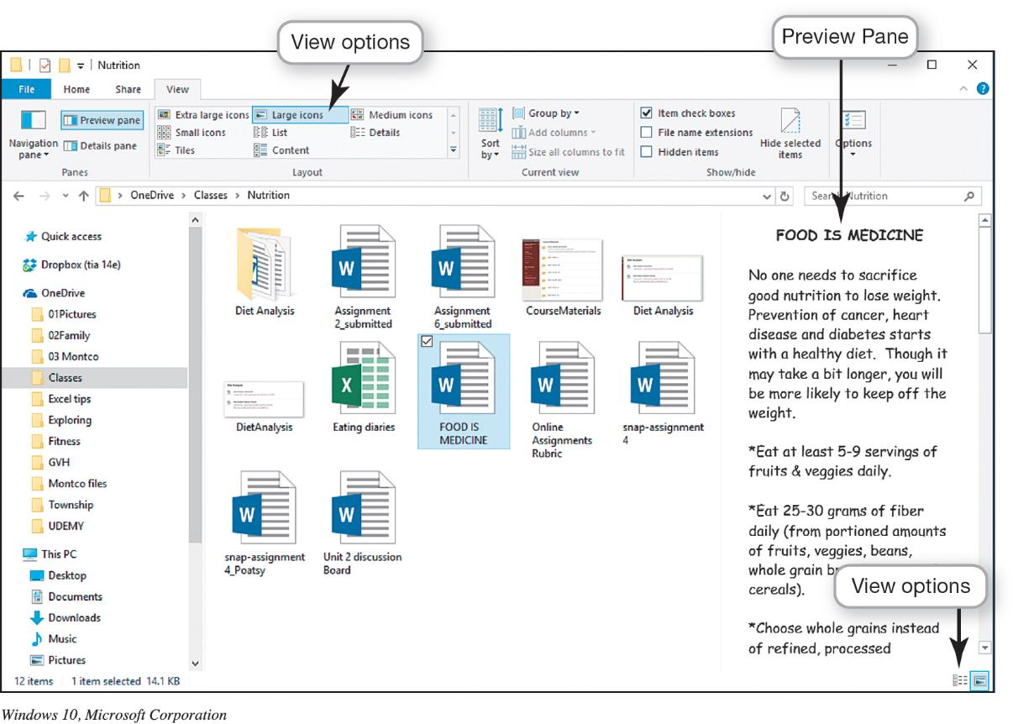
File Management
Organizing Your Files (3 of 6)
(Objective 5.9)
Notes:
This figure illustrates that the Large Icons view is a good way to display the contents of files and folders. The Preview pane on the right lets you see the first page of your document without first opening it. Large Icons is a good way to view files and folder, especially images.

Slide 35
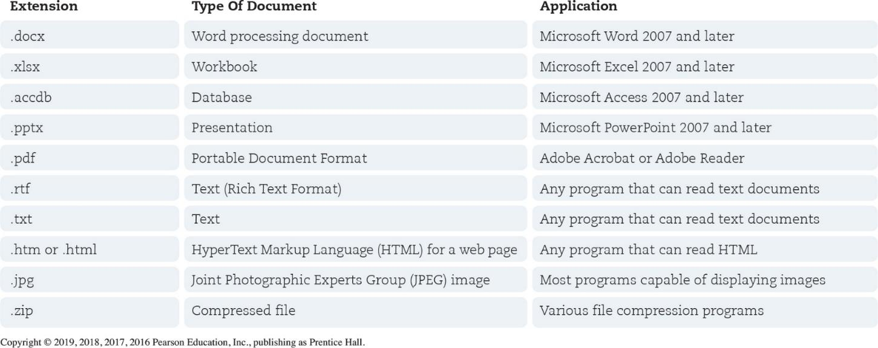
File Management
Organizing Your Files (4 of 6)
(Objective 5.9)
Naming files
  File name
  Extension (file type)
Notes:
The first part of a file, or the file name, is generally the name you assign to the file when you save it.
In a Windows application, an extension, or file type, follows the file name and a period or dot (.).
Figure 5.21 lists some common file extensions and the types of documents they indicate.

Slide 36
File Management
Organizing Your Files (5 of 6)
(Objective 5.9)
Copying, Moving, and Deleting Files
  Open
  Copy
  Cut
  Rename
  Delete
  Recycle bin
Notes:
You can perform many file management actions.
You can open a file by double-clicking the file from its storage location.
You can copy a file to another location using the Copy command.
To move a file from one location to another, use the Cut command.
You can rename a file.
You can delete files or folders.
The Recycle Bin is represented by an icon that looks like a recycling bin, where files deleted from the hard drive reside until you permanently purge them from your system.

Slide 37

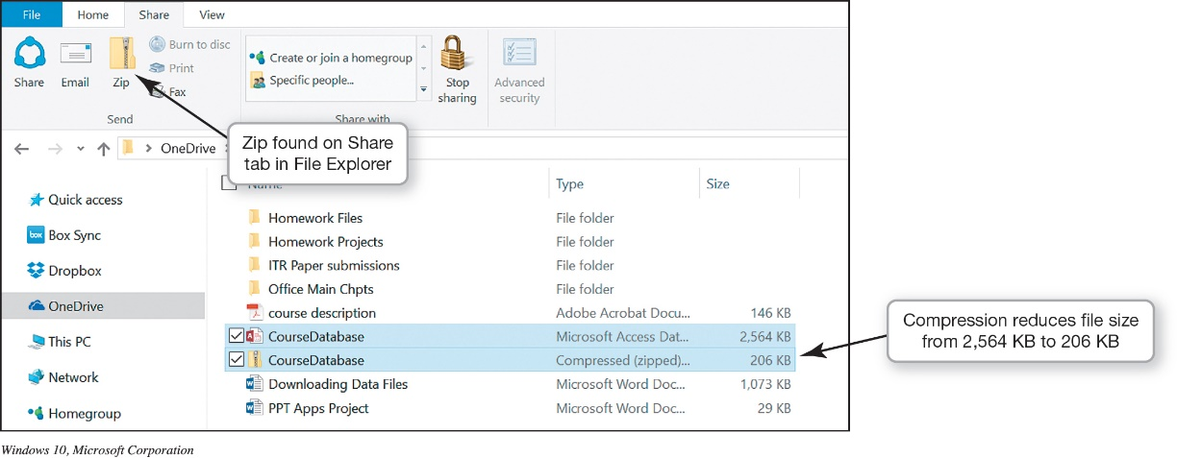
File Management Organizing Your Files (6 of 6)
(Objective 5.9)
File Compression utility
  Make a large file more compact
  Easier and faster to send files
  Built-in file compression
https://www.7-zip.org/
Notes:
File compression makes a large file more compact, making it easier and faster to send large attachments by e-mail, upload them to the web, or save them to a disc.
Windows has a built-in file compression utility that takes out redundancies in a file to reduce the file size. You can also obtain several standalone freeware and shareware programs, such as WinZip and StuffIt, to compress your files.

Slide 38
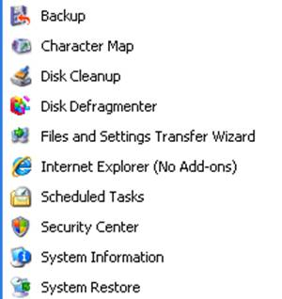
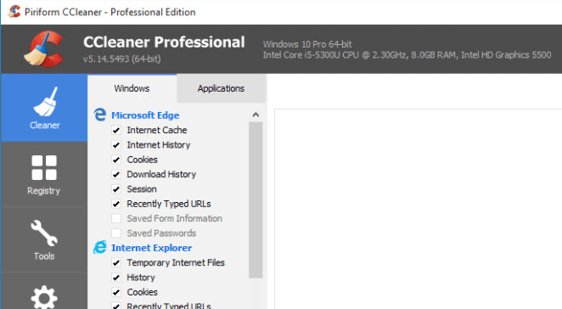

Utility Programs
(Objective 5.10)
Incorporated into the operating system
  Firewall and file-compression utilities
Standalone utility programs
  Antivirus and security programs
  Freeware
Notes:
Utility programs are small applications that perform special functions and come in three flavors:
Those that are included with the OS.
Those sold as standalone programs.
Those offered as freeware—anti-malware software like Ad-Aware from Lavasoft.
In general, the basic utilities designed to manage and tune the computer hardware are incorporated into the operating system.
The standalone utility programs typically offer more features or an easier user interface for backup, security, diagnostic, or recovery functions.

Slide 39
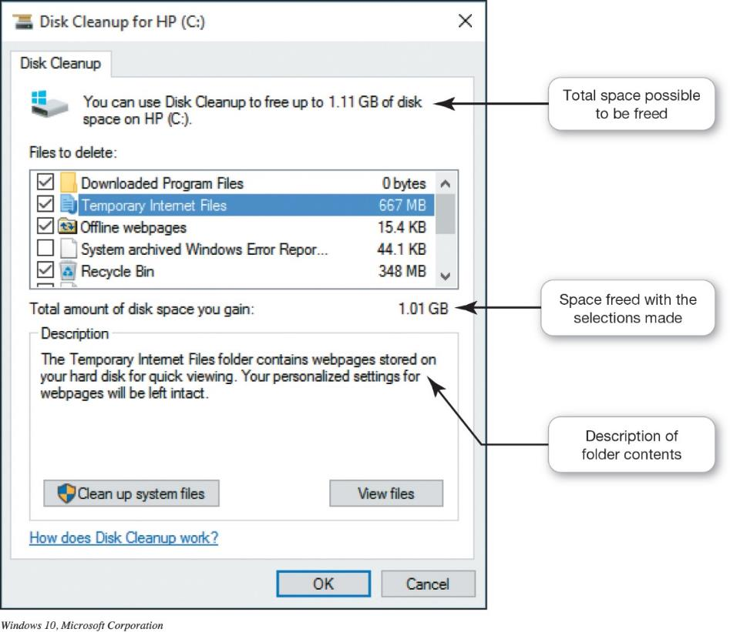
Utility Programs
Windows Administrative Utilities (1 of 3)
(Objective 5.10)
System Performance Utilities
  Disk Cleanup
  Task Manager
  Disk Defragmenter
Notes:
Disk cleanup removes unnecessary files from your hard drive.
Sometimes the system becomes confused, leaving references on the file allocation table or FAT to files that no longer exist or have been moved.
If a program has stopped working, you can use the Windows Task Manager utility to check on the program or to exit the nonresponsive program.
Disk defragmentation rearranges fragmented data so that related file pieces are unified.

Slide 40
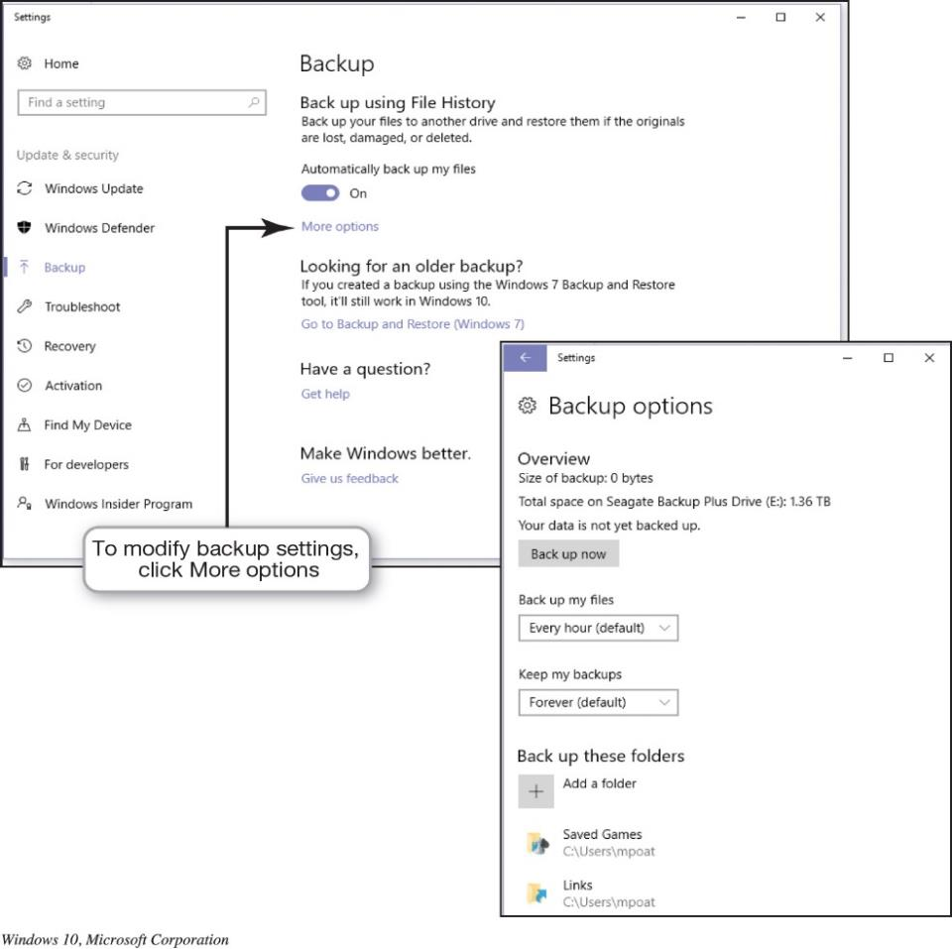
Utility Programs
Windows Administrative Utilities (2 of 3)
(Objective 5.10)
File and System
Backup Utilities
  File History
  System Restore
Notes:
When you use the File History utility, you can have Windows automatically create a duplicate of your libraries, desktop, contacts, and favorites and copy it to another storage device.
Windows has a utility called System Restore that lets you roll your system settings back to a specific date when everything was working properly.

Slide 41
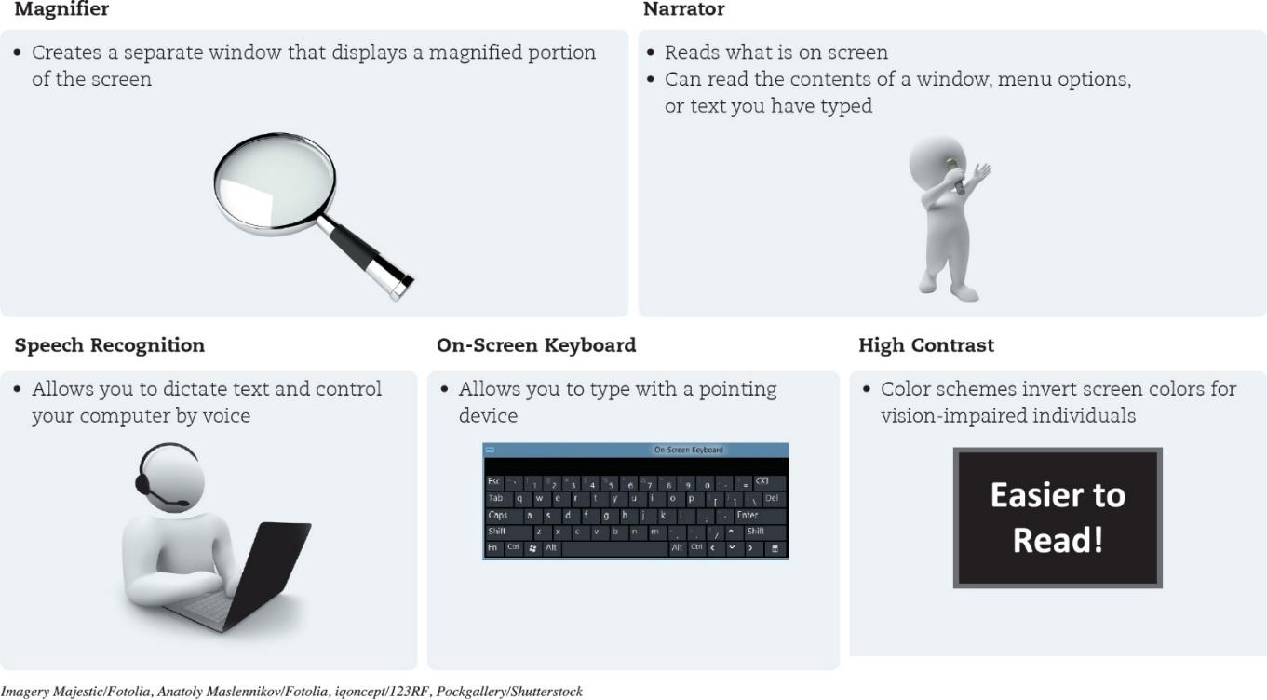
Utility Programs Windows Administrative Utilities (3 of 3) (Objective 5.10)
Accessibility Utilities
  Designed for users with special needs
Notes:
Microsoft Windows includes an Ease of Access Center, which is a centralized location for assistive technology and tools to adjust accessibility settings.
In the Ease of Access Center, you can find tools to help users with disabilities. If you’re not sure where to start or what settings might help, a questionnaire asks you about routine tasks and provides a personalized recommendation for settings that will allow you to better use your computer.

Slide 42
Questions
?

Slide 43

Copyright
All rights reserved. No part of this publication may be reproduced, stored in a retrieval system, or transmitted, in any form or by any means, electronic, mechanical, photocopying, recording, or otherwise, without the prior written permission of the publisher. Printed in the United States of America.

