Slide 1


Intro. to Python
Content and Corny Entertainment Provided by
Prof. Ryan Ammons, JD, MS-Soft.Eng.
rammons@nvcc.edu
www.ProfAmmons.com

Slide 2
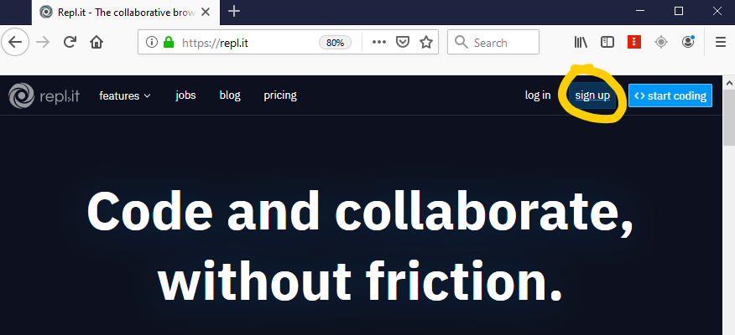
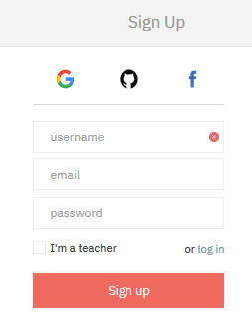
Getting Started
Repl.it – https://repl.it
Sign up for a free account on repl.it

Slide 3
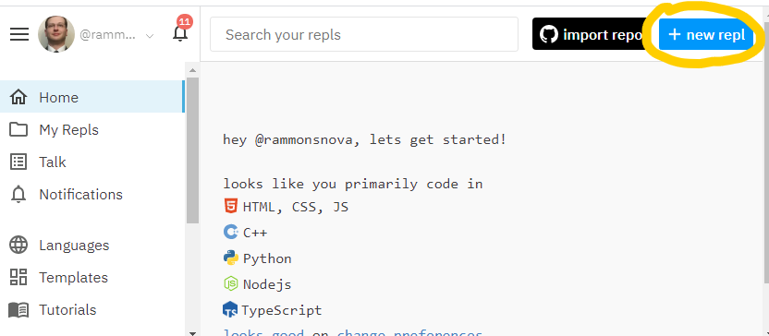
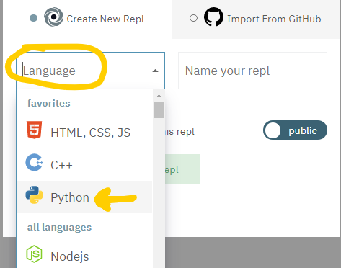
Getting Started
Repl.it – https://repl.it
Create a new repl
Select or type “Python”

Slide 4
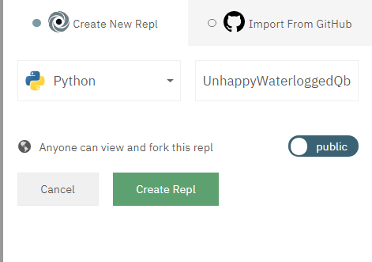
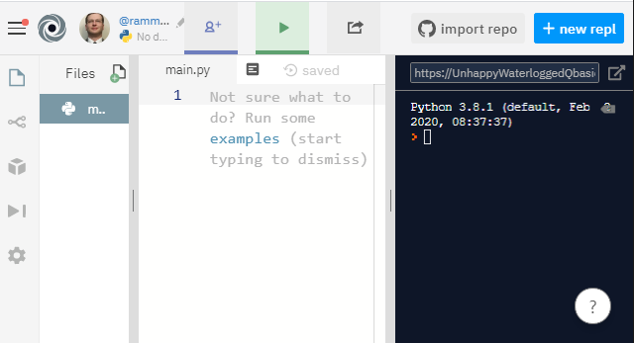
Getting Started
Repl.it – https://repl.it
Name it whatever you like, then click “Create Repl”
Your new workspace (“Repl”) is ready to rock ☺

Slide 5
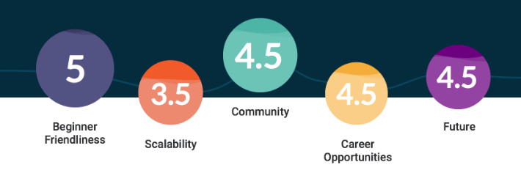
Why Python?
General-purpose language
Relatively easy to learn (vs. Java, C++, etc.)
Extremely popular:
  5th on StackOverflow
  4th on GitHub
  3rd largest Meetup community
Many uses:
  web development (Django)
  data analysis (NumPy, Pandas)
  artificial intelligence (TensorFlow, PyTorch)
  scientific computing (SciPy)
  …and many many other uses… (PyGame)

Slide 6
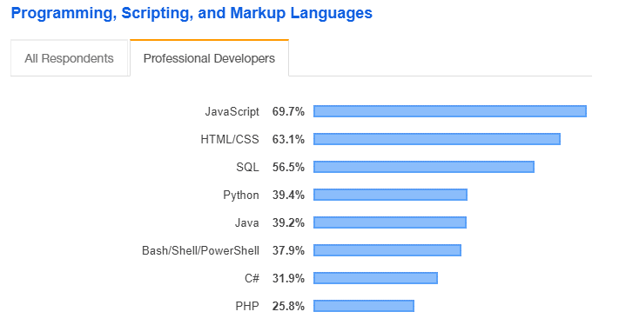
Usage in Industry
Source: Developer Survey by StackOverflow

Slide 7
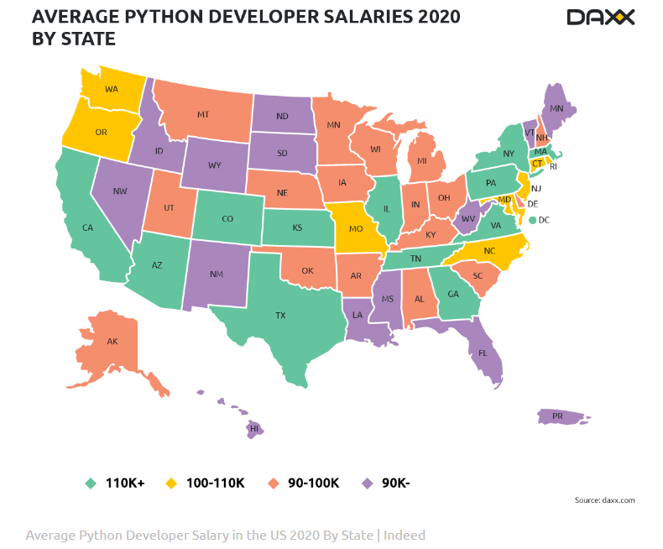

Slide 8
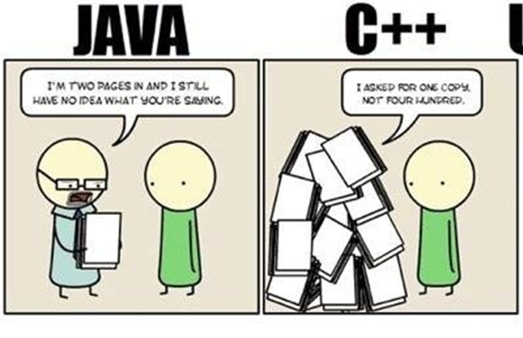
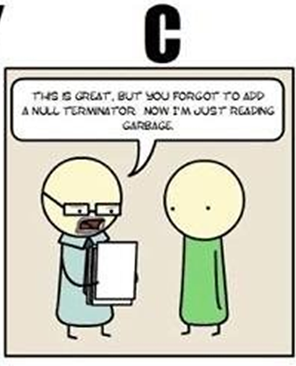
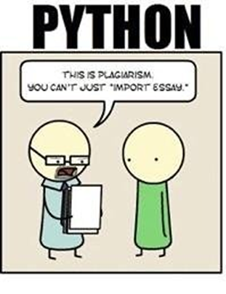
Comic relief: Java
I’m two pages in and I still have no idea what you’re saying.
I asked for ONE copy, not four hundred…
This is great, but you forgot to add a NULL terminator…now I’m just reading nonsense.
This is plagiarism.
You can’t just “import essay”!
Source: Cyanide and Happiness

Slide 9
Comic relief: C++
I’m two pages in and I still have no idea what you’re saying.
I asked for ONE copy, not four hundred…
This is great, but you forgot to add a NULL terminator…now I’m just reading nonsense.
This is plagiarism.
You can’t just “import essay”!
Source: Cyanide and Happiness

Slide 10
Comic relief: C
I’m two pages in and I still have no idea what you’re saying.
I asked for ONE copy, not four hundred…
This is great, but you forgot to add a NULL terminator…now I’m just reading nonsense.
This is plagiarism.
You can’t just “import essay”!
Source: Cyanide and Happiness

Slide 11
Comic relief?
I’m two pages in and I still have no idea what you’re saying.
I asked for ONE copy, not four hundred…
This is great, but you forgot to add a NULL terminator…now I’m just reading nonsense.
This is plagiarism.
You can’t just “import essay”!
Source: Cyanide and Happiness

Slide 12
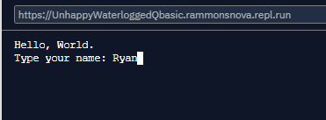
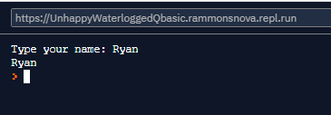
Input/Output – print() and input()
Use print() to “print” to screen
  print("Hello, world.")
Use input() to get input from user
  input(“Type your name: ")
  # Save the output to a variable called 'name':
  name = input(“Type your name: ")
  # ‘print’ the value in 'name' to the screen
  print(name)
https://www.w3schools.com/python/python_intro.asp
https://www.w3schools.com/python/python_user_input.asp

Slide 13
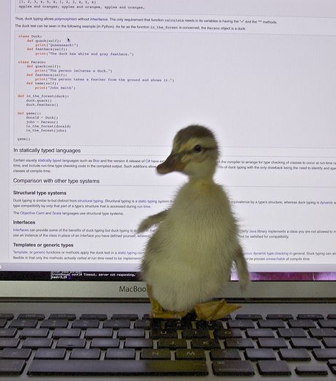
Variables – Quack, quack?
Variables…placeholders for values
  NO TYPE needed (dynamic-typing / duck-typing)
  int, str, bool, float (and many more…)
  Examples:
    Create empty variable 'x': x
    Create variable with value True: python_is_cool = True
    Create 'y', set to 10: y = 10
    Set 'x' to '10': x = "10"
https://www.w3schools.com/python/python_variables.asp
https://www.w3schools.com/python/python_datatypes.asp

