Slide 1
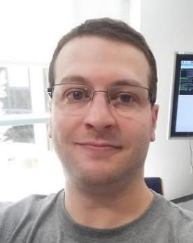
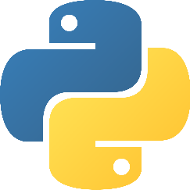
Intro. to Python
Content and Corny Entertainment Provided by
Prof. Ryan Ammons, JD, MS-Soft.Eng.
rammons@nvcc.edu
www.ProfAmmons.com

Slide 2


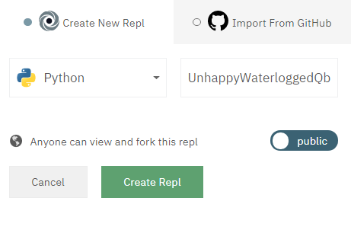
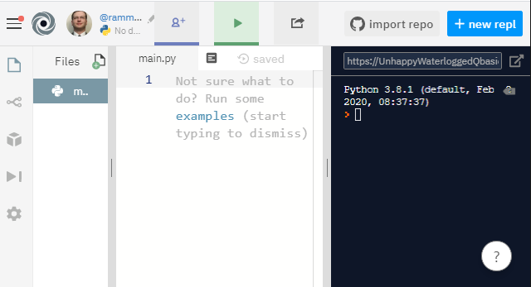
Getting Started
Repl.it – https://repl.it
Click , choose “Python”, name it whatever you like, then click
Your new workspace (“Repl”) is ready to rock ☺

Slide 3
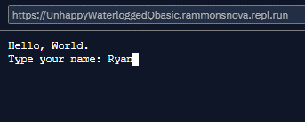
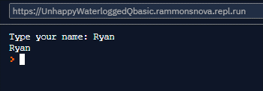
Review: Input/Output – print() and input()
Use print() to “print” to screen
  print("Hello, world.")
Use input() to get input from user
  input(“Type your name: ")
  # Save the output to a variable called 'name':
  name = input(“Type your name: ")
  # ‘print’ the value in 'name' to the screen
  print(name)
https://www.w3schools.com/python/python_intro.asp
https://www.w3schools.com/python/python_user_input.asp

Slide 4
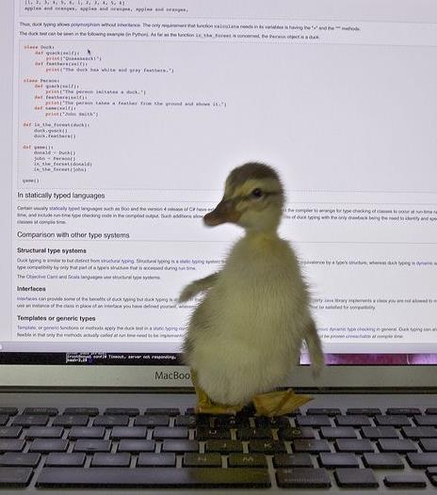
Review: Variables – Quack, quack?
Variables…placeholders for values
  NO TYPE needed (dynamic-typing / duck-typing)
  int, str, bool, float (and many more…)
  Examples:
    Create empty variable 'x': x
    Create variable with value True: python_is_cool = True
    Create 'y', set to 10: y = 10
    Set 'x' to '10': x = "10"
https://www.w3schools.com/python/python_variables.asp
https://www.w3schools.com/python/python_datatypes.asp

Slide 5
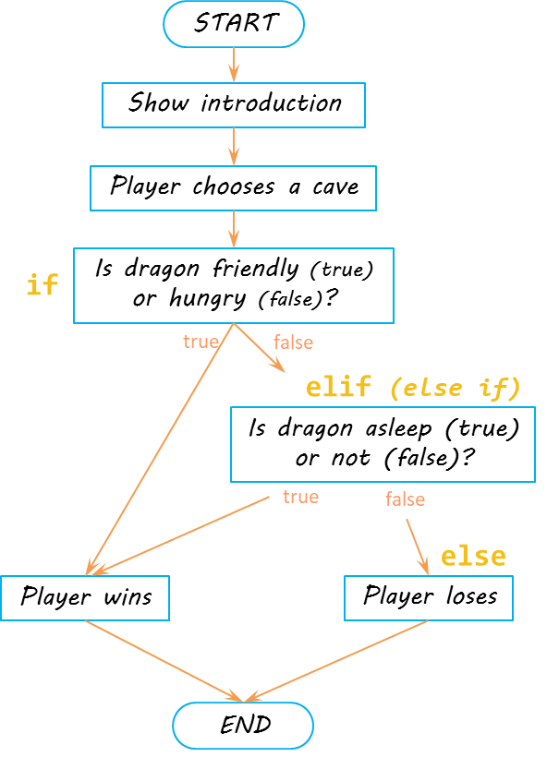
Review: Branching – if/elif/else
Branching – many paths
  if dragon_is_friendly:
  print("dragon friendly, win!")
  elif dragon_is_asleep:
  print("dragon asleep, win!")
  else:
  print("not friendly, not asleep")
  print("lose...")
https://www.w3schools.com/python/python_conditions.asp

Slide 6
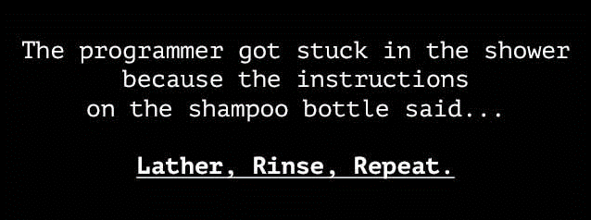
Repetition, Loops – Comic Relief

Slide 7
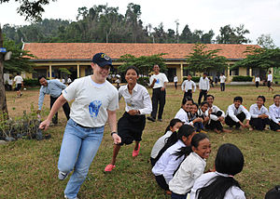
Repetition – do something over and over…and over
Repetition – repeating code
  ducks = int(input("How many ducks until goose?"))
  if ducks == 1:
  print("duck")
  elif ducks == 2:
  print("duck")
  print("duck")
  elif ducks == 3:
  print("duck")
  print("duck")
  print("duck")
  print("GOOSE!")
Duck, Duck, Goose game (source: Wikipedia)
https://www.w3schools.com/python/python_conditions.asp

Slide 8
Looping – while loop
START
How many ducks?
while loop – repeat…repeat…repeat?
count = 0
ducks = ?
*like an if
ducks = int(input("How many ducks until goose?"))
count = 0
while count < ducks:
print("duck")
count = count + 1
print("GOOSE!")
while
count < ducks ?
true
false
Print “duck”
count = ?
Add 1 to count
Print “GOOSE!”
END
https://www.w3schools.com/python/python_while_loops.asp

